Slide 1

INTRODUCTION

Slide 2
DEFINITIONS
May be considered as knowledge, know how, skills, innovations or practices; that are passed between generations, with in the communities and they form part and parcel of your community.
Is knowledge that derives from, or is rooted in the traditional way of life of aboriginal people
Is the accumulated knowledge and understanding of the human place in relation to the universe

Slide 3
AGRICULTURE IN INDIA
India is an agriculturally important country.
Agriculture produces most of the food we consume.
Agriculture also produces raw materials for various industries.
India is the second in the world in crop output, next to china.
1.4 million square-kilometers of land in India is under cultivation.
Agriculture is India’s biggest economic sector and employs 52.1% of total workforce.

Slide 4
WHAT IS AGRICULTURE?
Agriculture is the deliberate tending of crops and livestock in order to produce food and fiber.

Slide 5
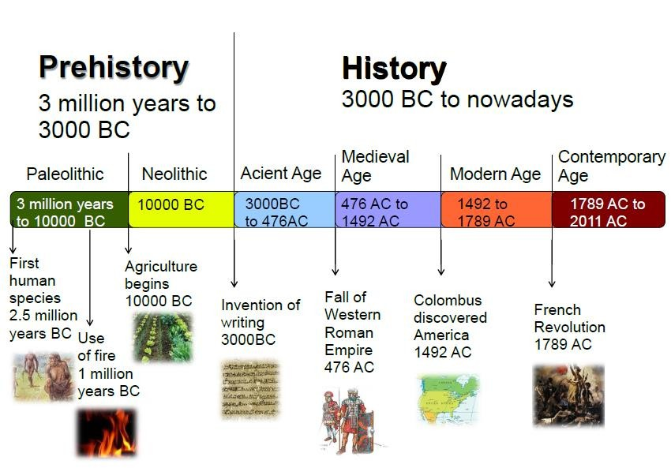
The History of agriculture

Slide 6
Early agricultural settlements
Rural land use and settlement patterns
What is a land-use model?
A Land use model shows the different ways that people use the land that is available to them.

Slide 7
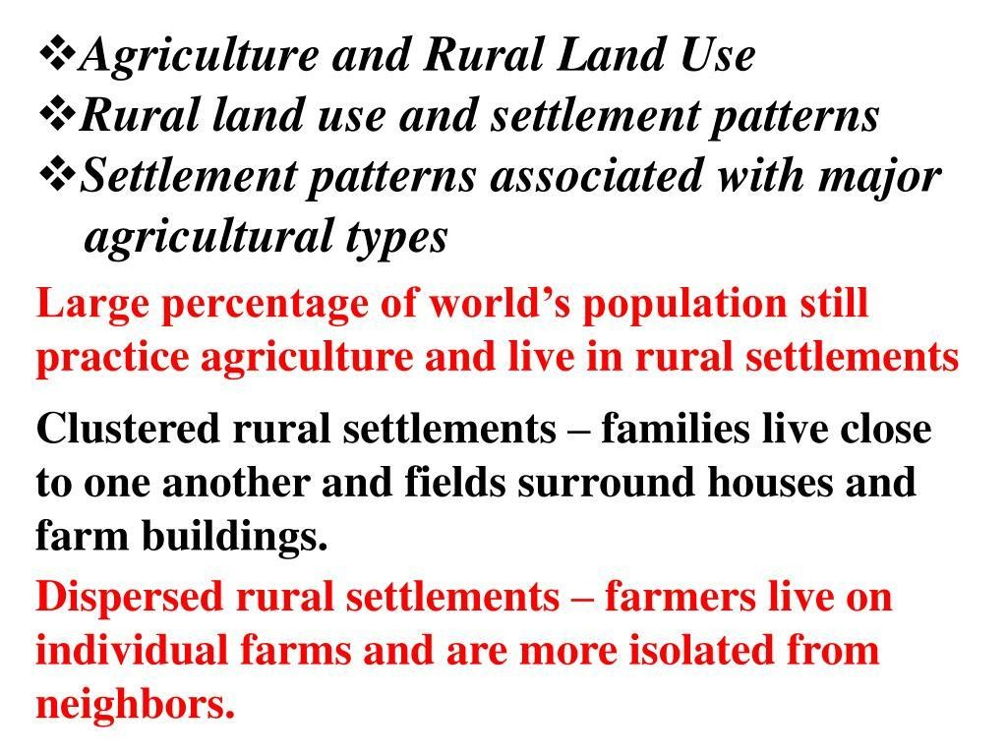
Patterns of settlements

Slide 8
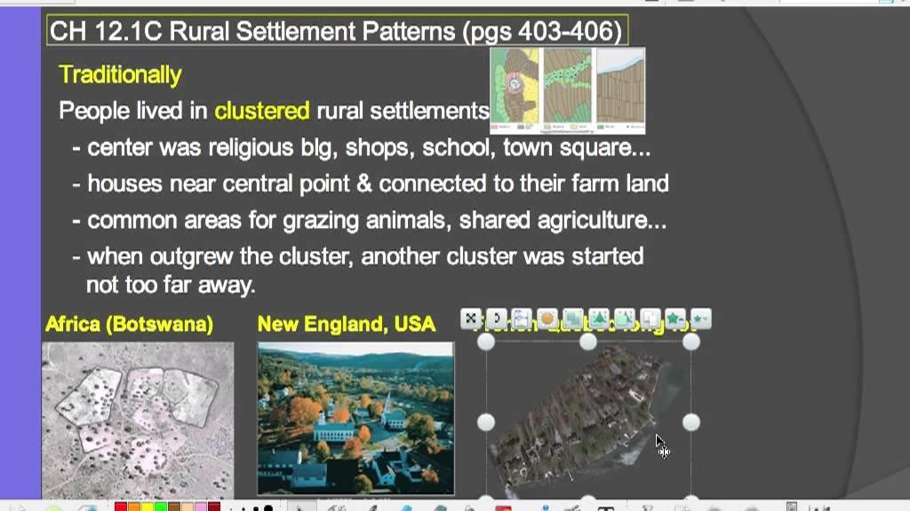

Slide 9
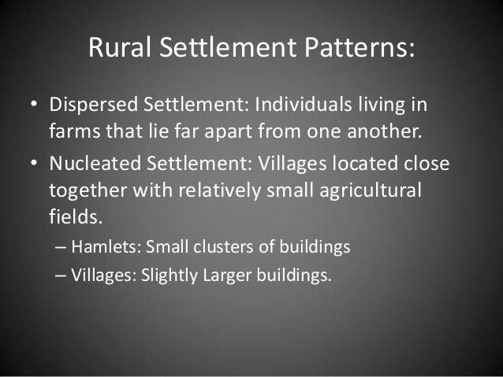

Slide 10
Factor influence agriculture
Physical factors
Climate
Soils
Topography
Economic factors
Market
transport facilities
Capital
Labour
Government policies
3. Other factors

Slide 11
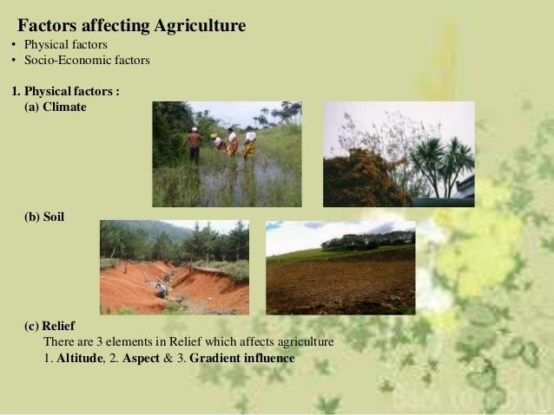

Slide 12
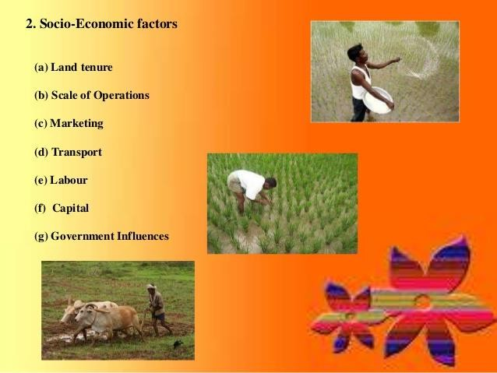

Slide 13
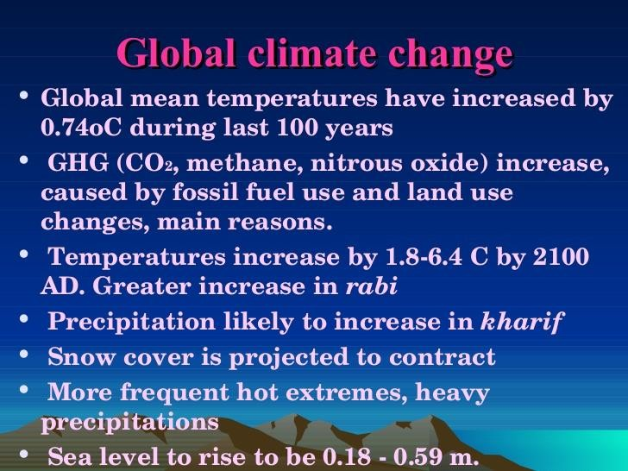
Climate Change: Impacts on Indian Agriculture

Slide 14
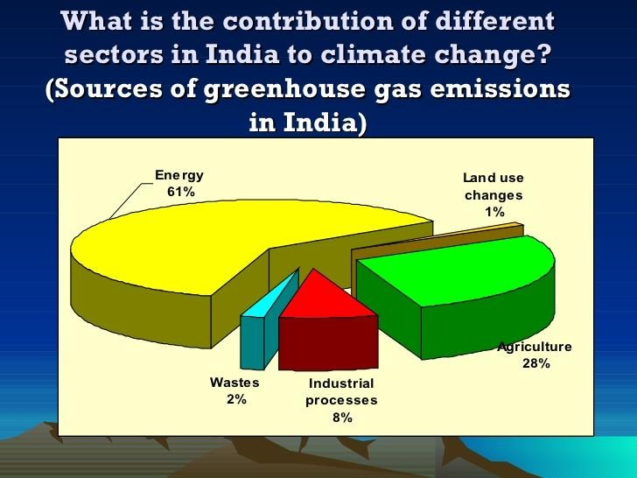

Slide 15
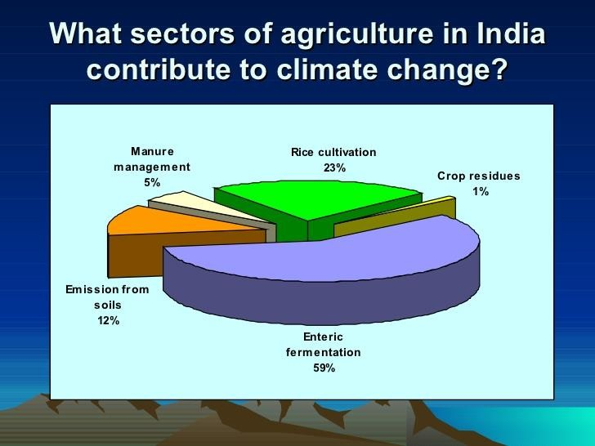

Slide 16
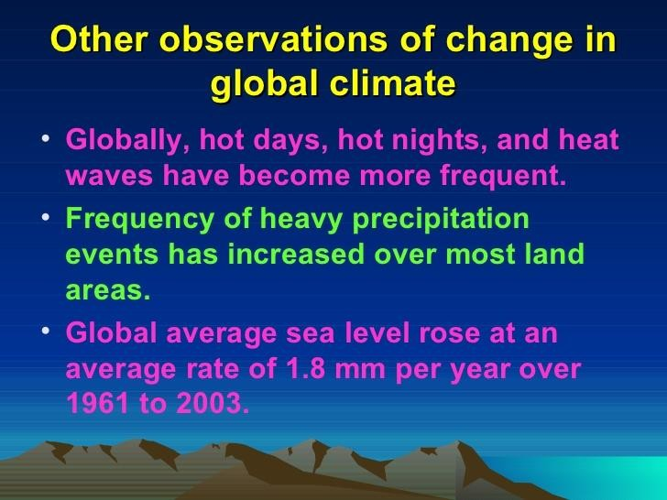

Slide 17
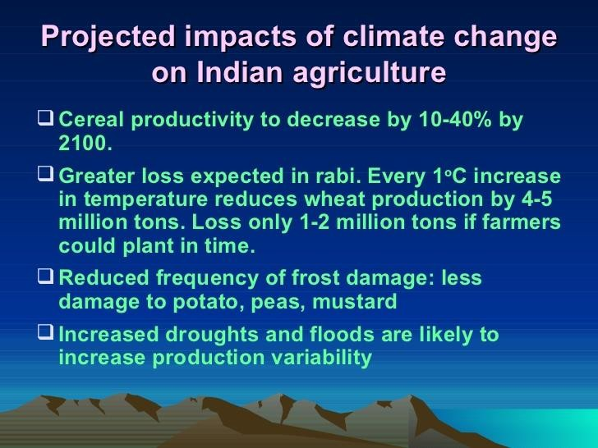

Slide 18
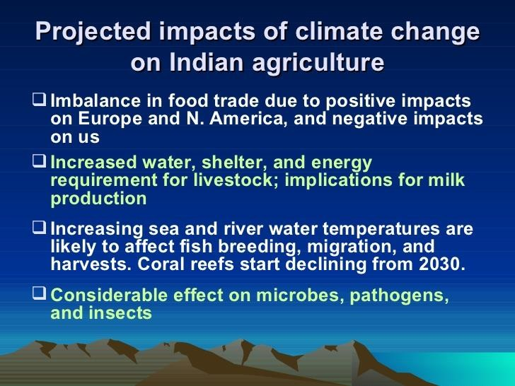

Slide 19
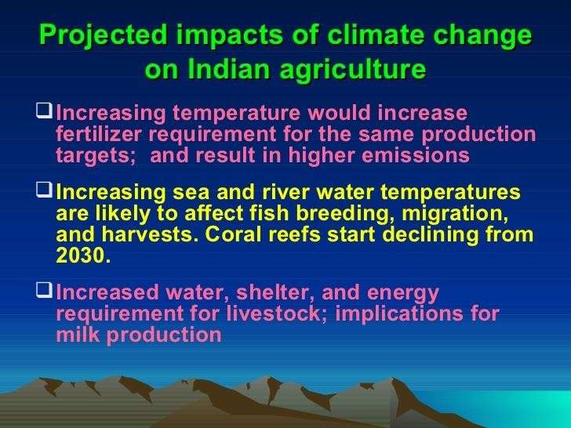

Slide 20
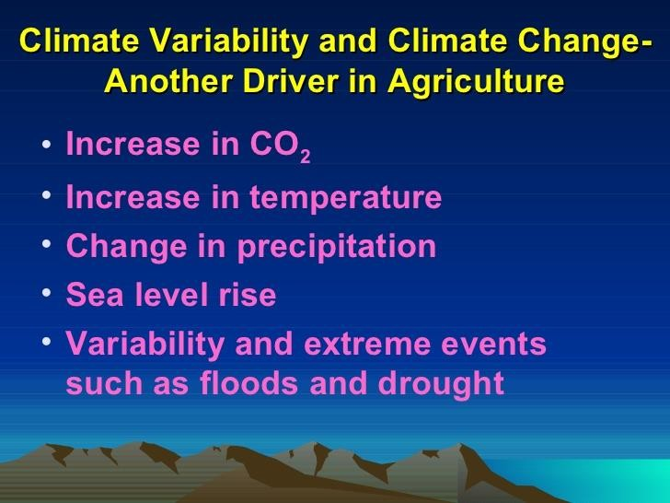

Slide 21
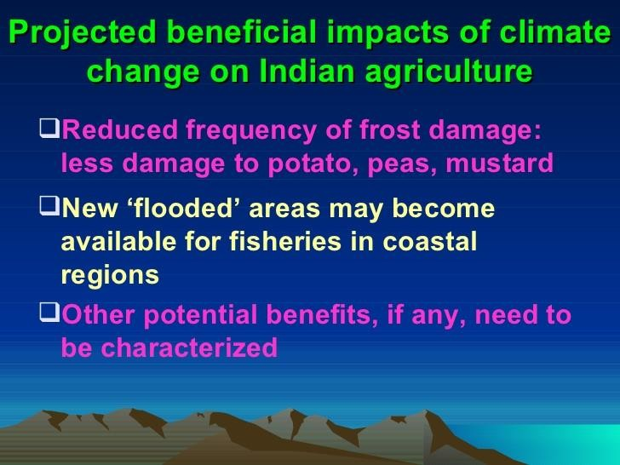

Slide 22
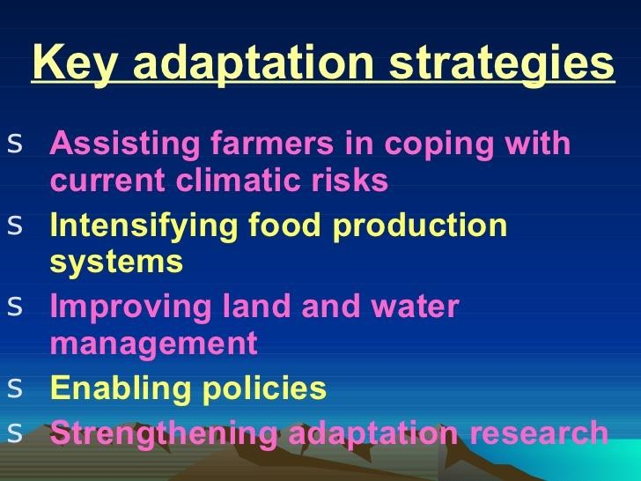

Slide 23
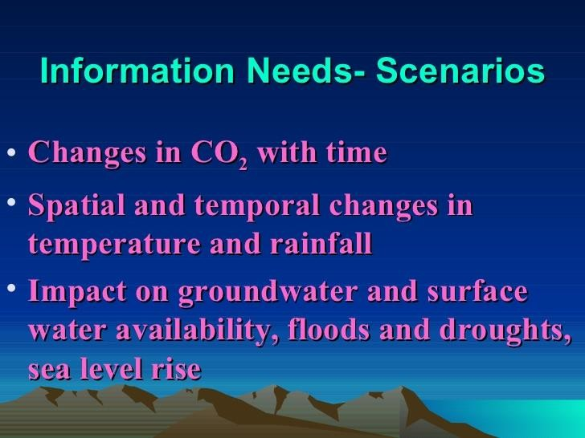

Slide 24
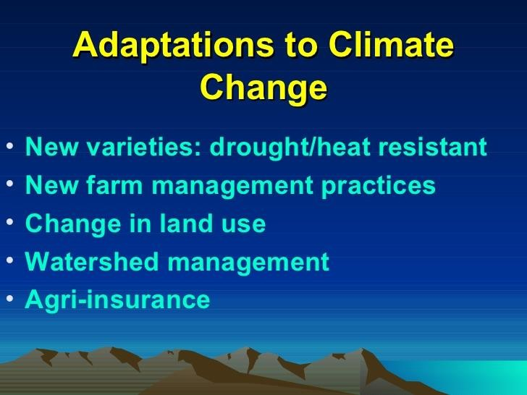

Slide 25
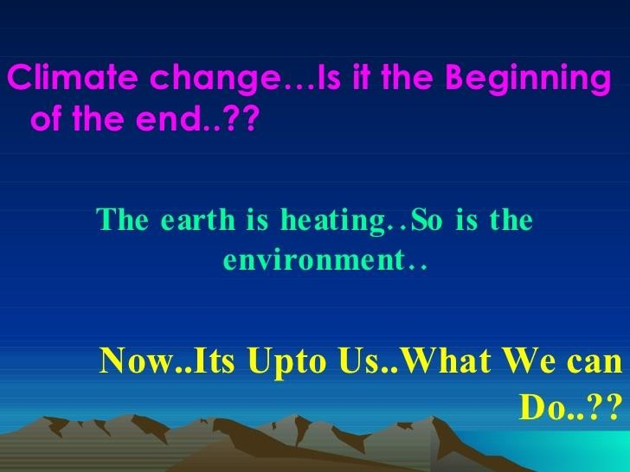

Slide 26
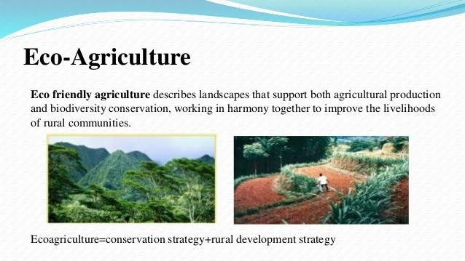
Crop Cultivation-Environment Friendly Practices

Slide 27
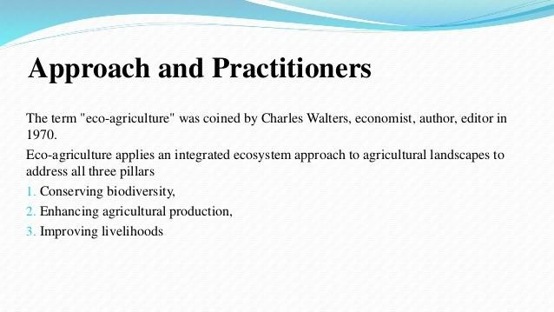

Slide 28
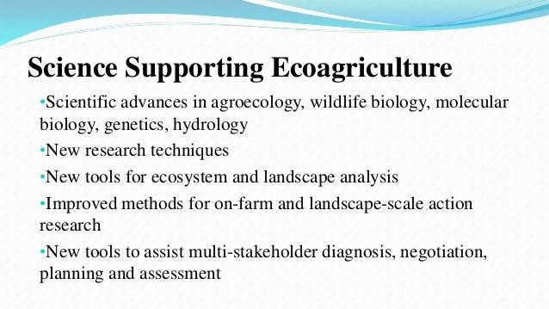

Slide 29
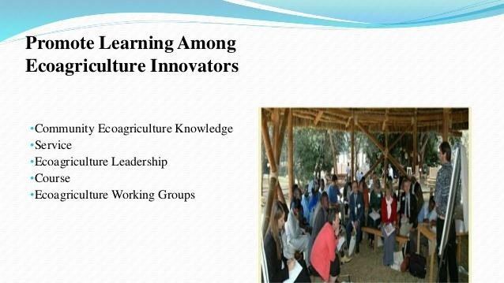

Slide 30
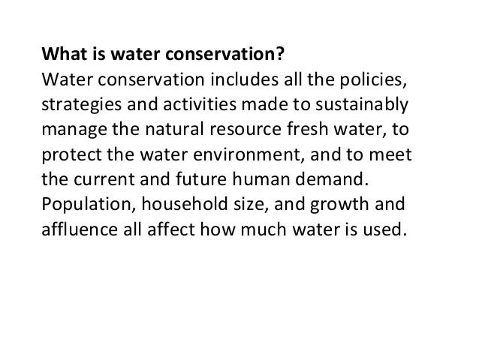

Slide 31
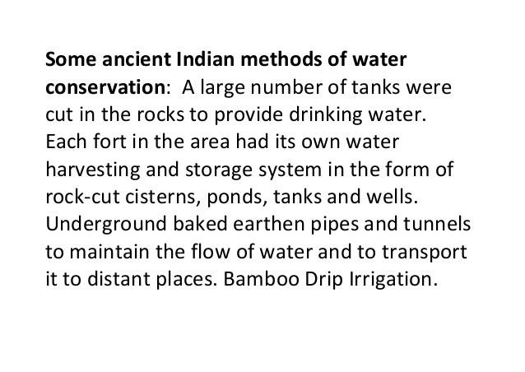

Slide 32
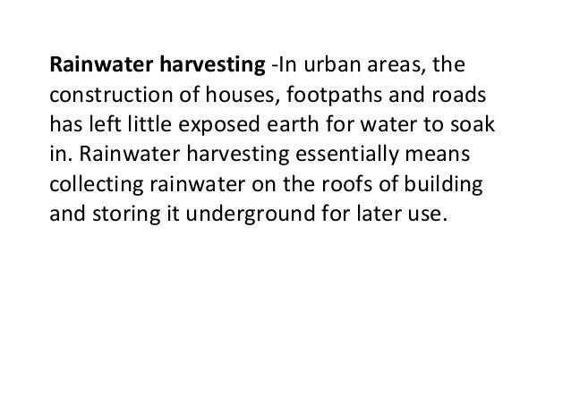

Slide 33
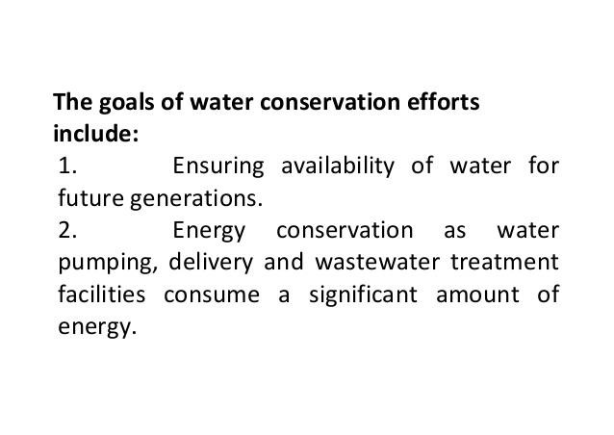

Slide 34
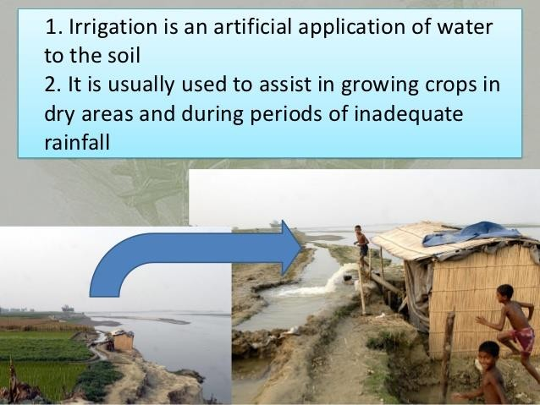
Irrigation

Slide 35
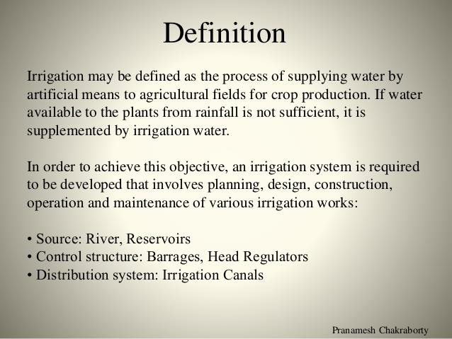
Types of Irrigation

Slide 36
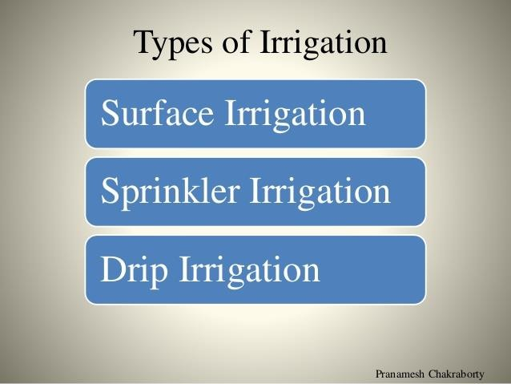

Slide 37
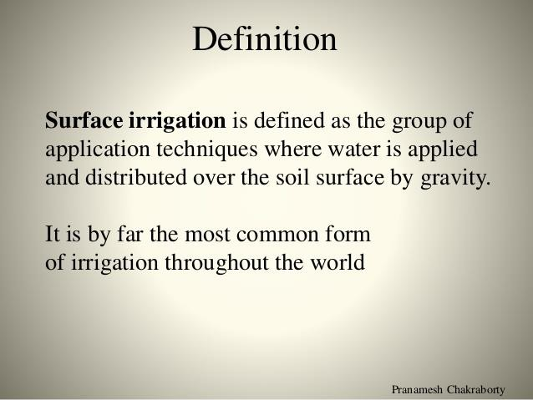

Slide 38
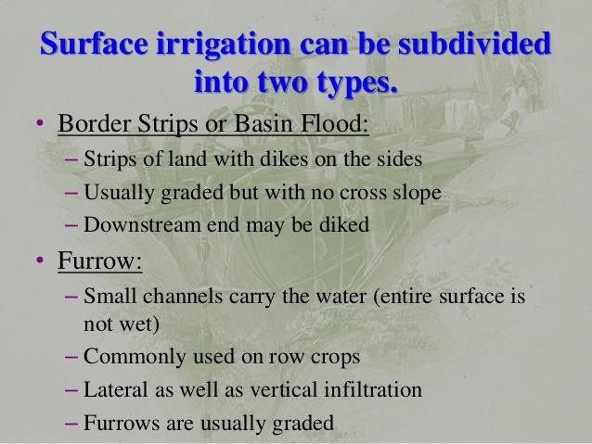

Slide 39
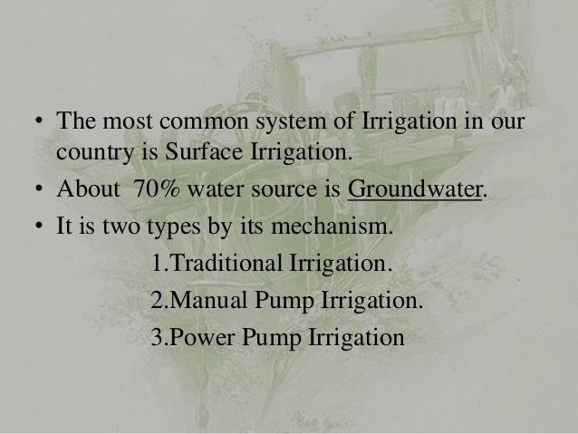

Slide 40
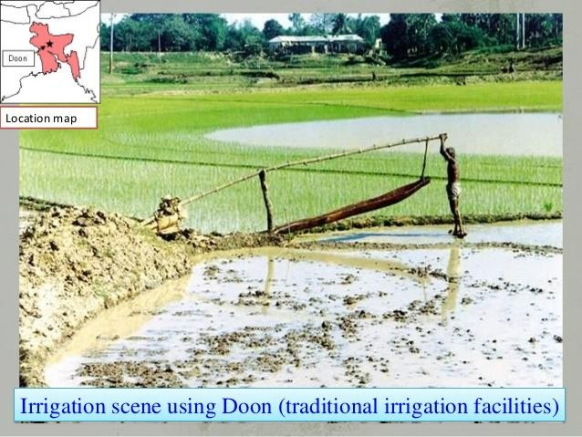
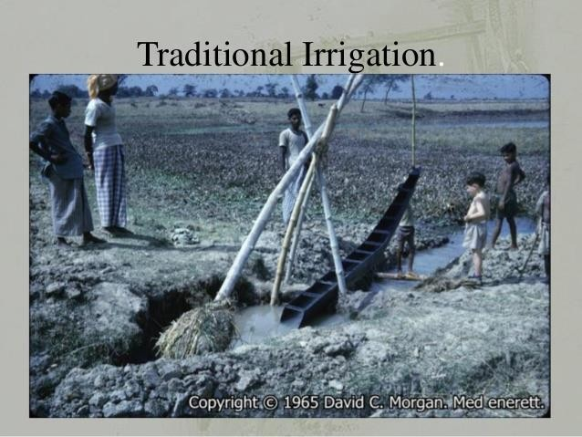

Slide 41
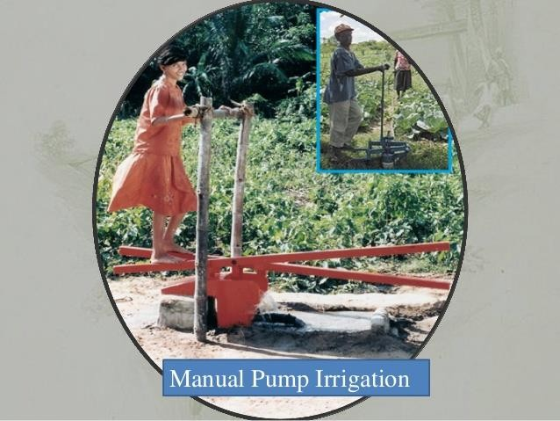
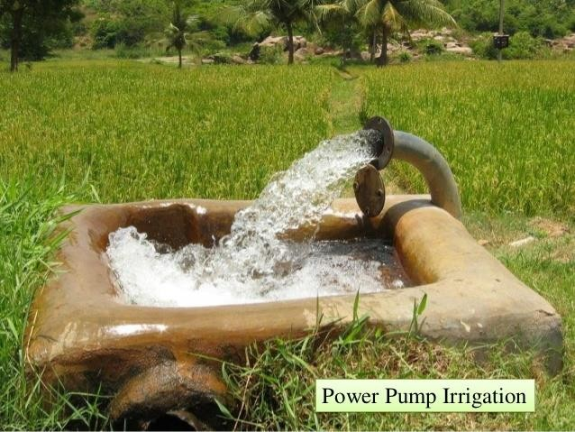

Slide 42
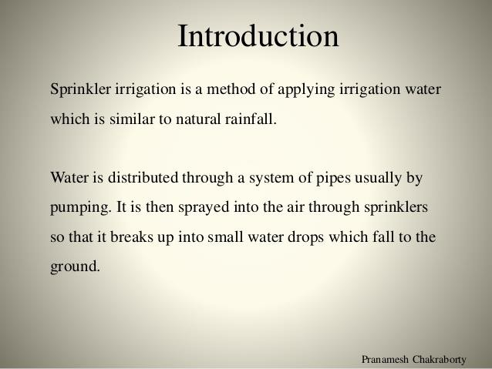

Slide 43
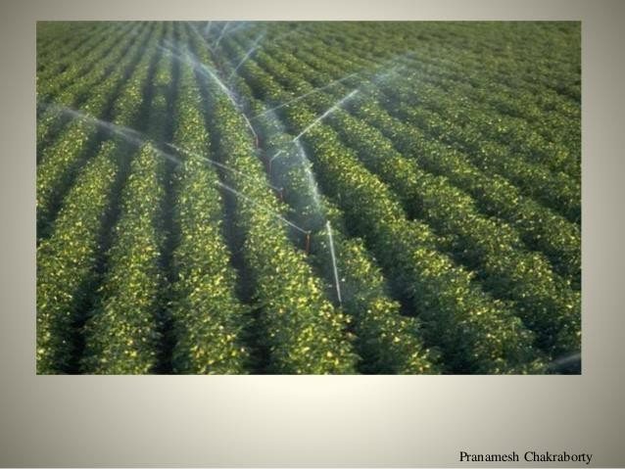
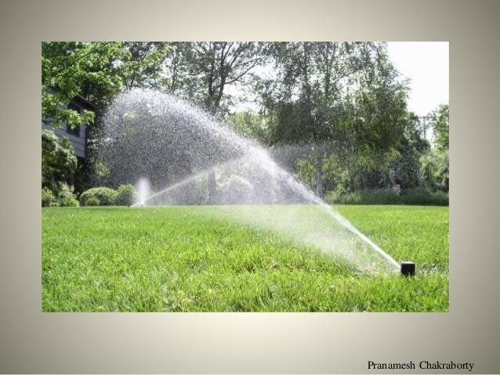

Slide 44
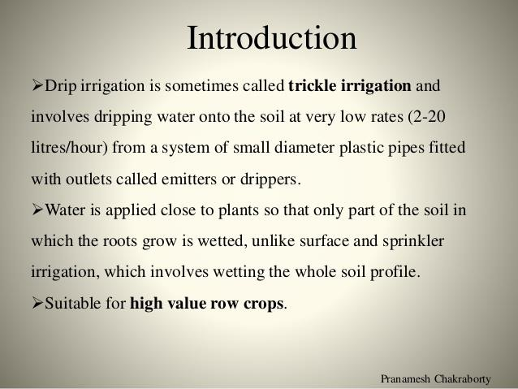

Slide 45
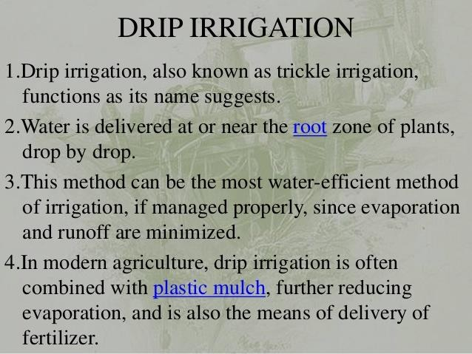

Slide 46
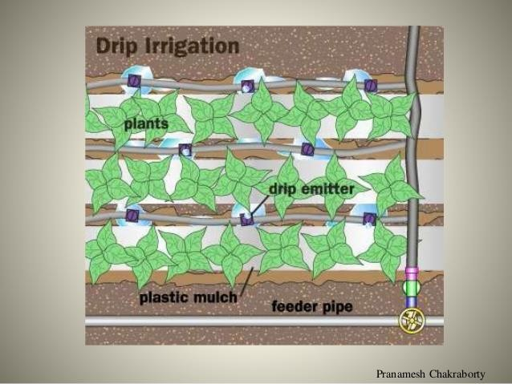
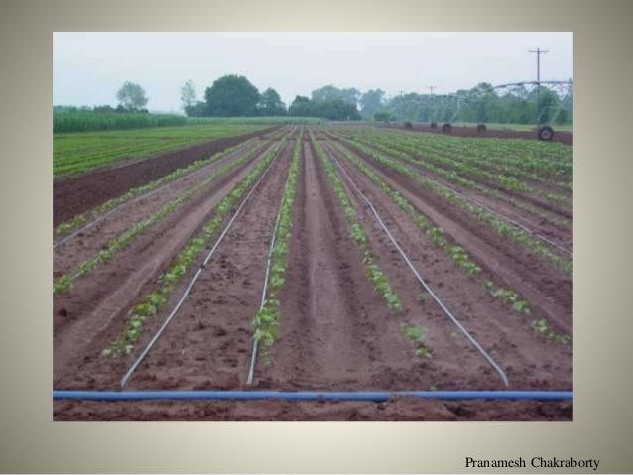

Slide 47
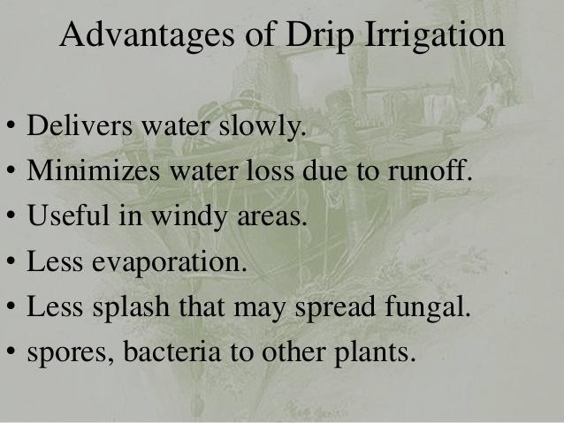

Slide 48
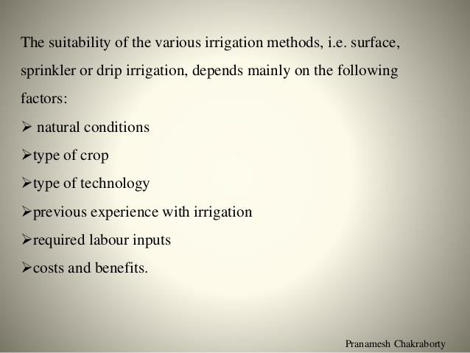

Slide 49
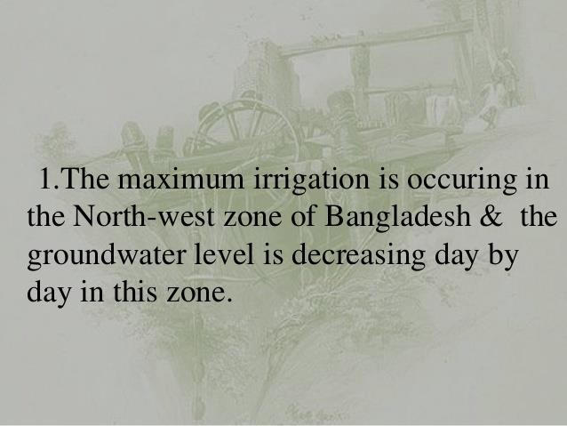
Problems Faced by Irrigation

Slide 50
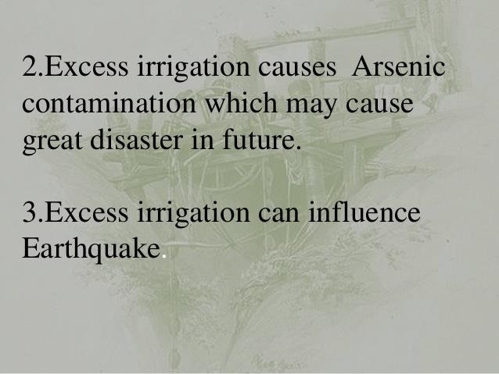

Slide 51
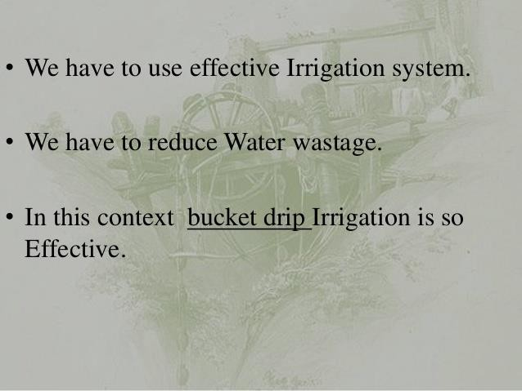
What should we do?

Slide 52
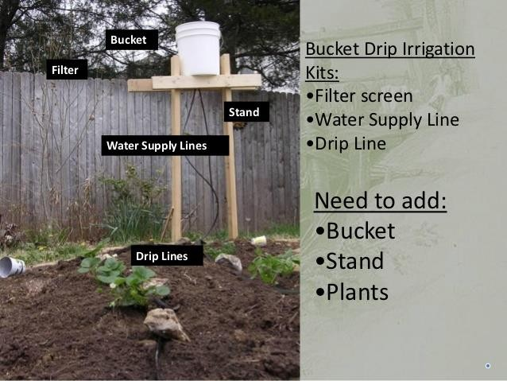

Slide 53


Slide 54



Slide 55


